Slide 1
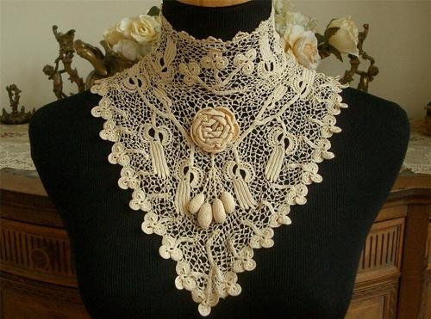
Муниципальное автономное общеобразовательное учреждение «Средняя школа п.Угловка»
Исследовательский проект
на тему
«Irish Crochet Lace»
(«Ирландское кружево»)
Выполнили: Трифанова Елена, Квитченко Анастасия обучающиеся 10 класса
Руководитель: Федорова Юлия Владимировна учитель английского языка

Slide 2
Irish Crochet Lace has always been an important part of the Irish tradition.
The aim of our project:
to find out the information about Irish crochet lace
Tasks:
to collect the necessary material about Irish crochet lace;
to make the presentation;
to present the project to the class.

Slide 3
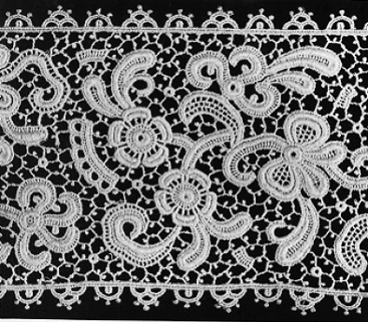
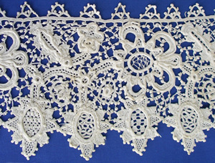
Irish Crochet Lace
A tribute to the human spirit.
Beauty born of necessity.
Conceived from lowly beginnings,
With a dream of higher aspirations,
It grew out of patience, perseverance and ingenuity,
To stand in majesty,
To feed a nation.

Slide 4
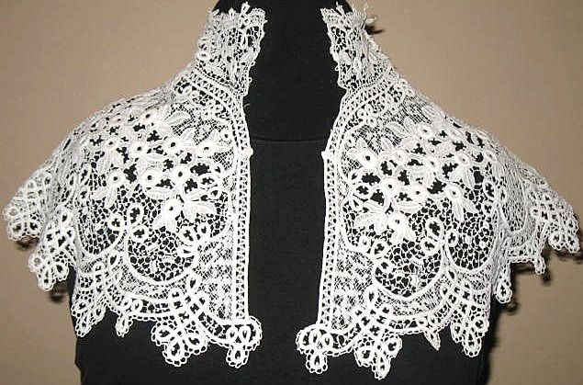
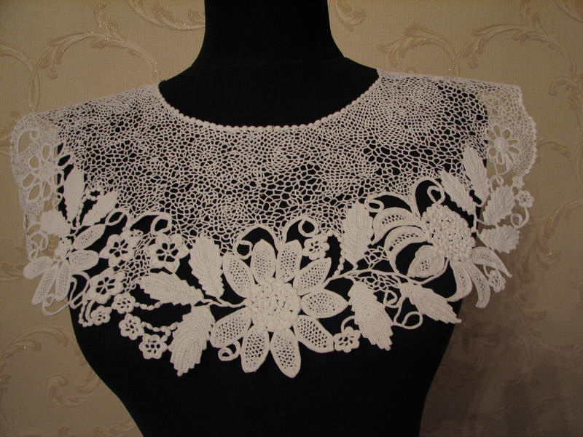
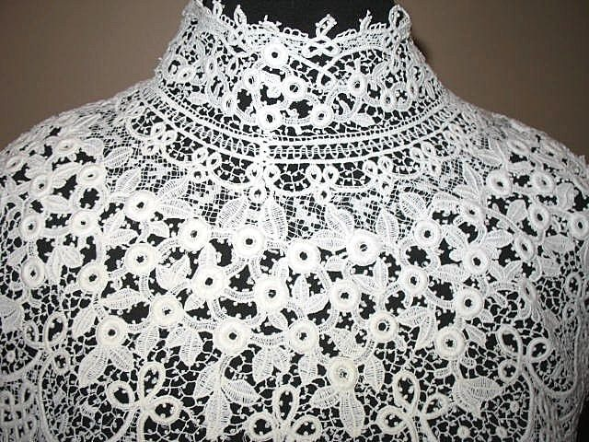

Slide 5
Irish Crochet Lace is made with a very fine steel crochet hook and fine crochet cotton or linen thread. It begins with an outline of the pattern on a piece of cloth. Each motif is then crocheted separately, using cotton cord for volume and shaping. The finished motifs are then basted (sewn with a loose stitch for temporary tacking) onto a cloth in the shape of the pattern. The motifs are then joined using chains and picots. When all the motifs have been joined together forming one piece of lace the basting stitch is removed from the back cloth revealing the completed lace.

Slide 6
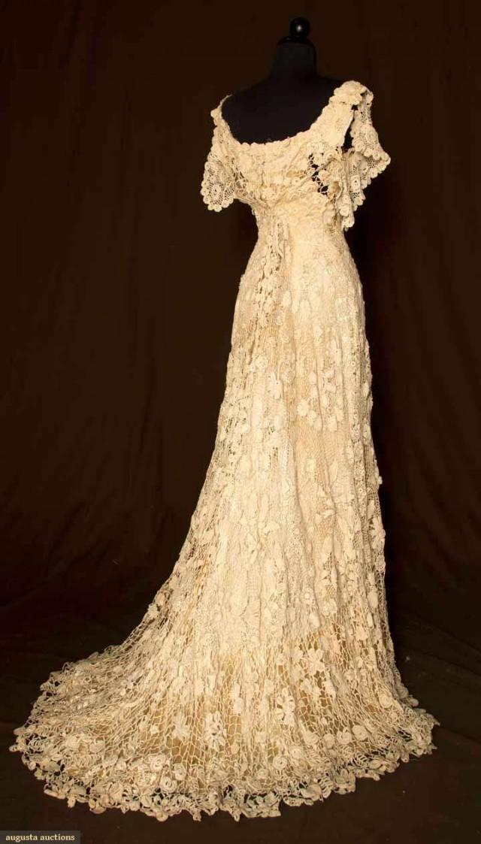
The most beautiful of materials, lace worn by the wealthiest women across Europe, were produced by some of the poorest women in Ireland. Lace was a luxury commodity, used to decorate elaborate wedding dresses, christening robes, and church vestments, but it also played a vital part in saving many families from starvation and destitution. Irish lace reflects the social and political changes that took place between 1700 and the present.

Slide 7
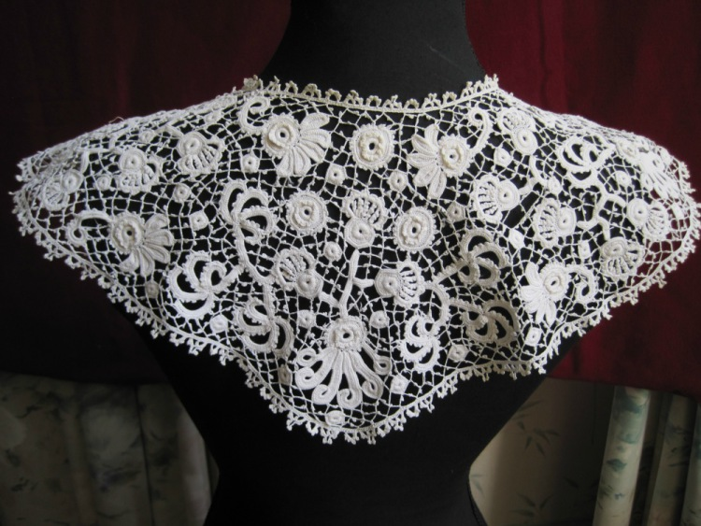
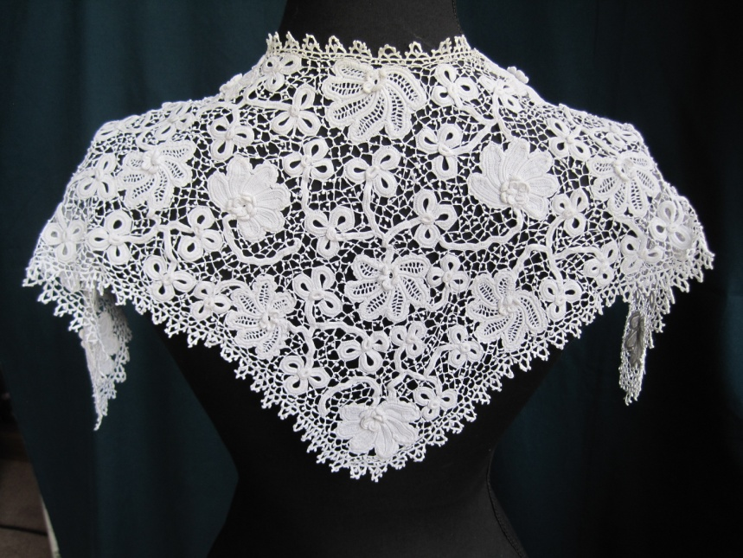
Hook Method
You can use a hook to create the background net. Historically, this type of crochet was known as early as 1743 when the Royal Dublin Society awarded prizes for it. Over the years, workers expanded on these teachings to create the richly sculpted texture of the motifs we see today.

Slide 8
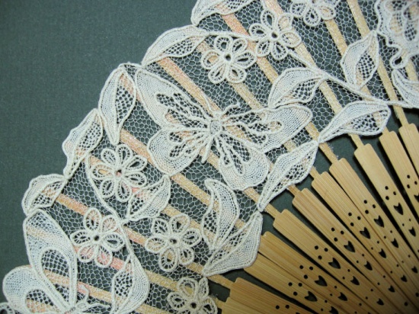
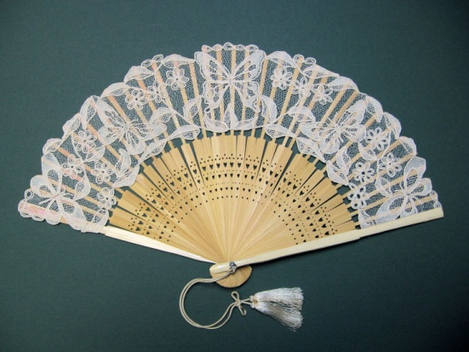
Needle Method
Lace made with a needle in Ireland from the late 1840s, when the craft was introduced as a famine-relief measure. Technically and stylistically influenced by 17th-century Venetian needle lace, it arose in several centers through the enterprise of individuals, especially the mother superiors of convents, who unraveled old examples to learn the technique and then taught the pupils of convents or local schools. You can use a needle to create the background net.

Slide 9
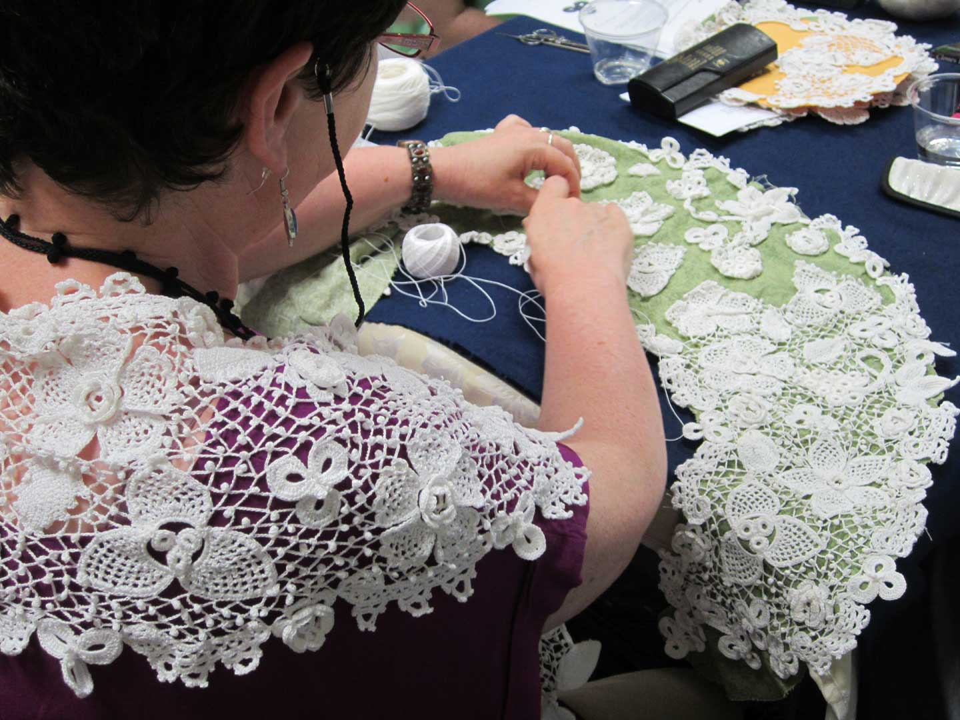
Several lace-making schools were established throughout Ireland. By the turn of the twentieth century, nearly every family in the west and southeast area was involved in the lace industry and by 1901, Clones was the most important center for the production of crochet lace in Ireland.

Slide 10
Conclusion
When we began searching for information regarding Irish Crochet Lace we were very impressed with the history of it and as a result, we have become fans of Clones Lace and we are still in the process of learning the techniques of making the motifs. It was the most exciting project that we have ever done.

Slide 11
Internet resources
https://en.wikipedia.org/wiki/Irish_lace
http://www.antiquepatternlibrary.org/html/warm/irishcro.htm
https://www.youtube.com/watch?v=20huNJ40mCI
http://global.britannica.com/topic/Irish-needle-lace
https://crochetthread.wordpress.com/irish-crochet/

